Slide 1

Plant Pals
Customer Survey Results
Survey conducted post-improvement measures in product quality, delivery timelines, and customer support.

Slide 2
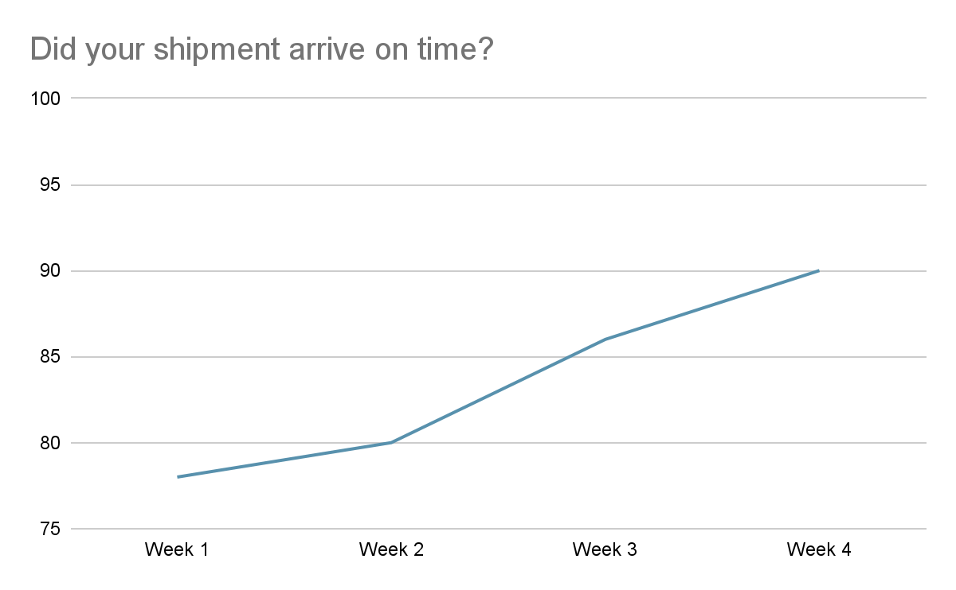
Did your shipment arrive on time?
[Insert chart or graph here]
Key takeaways & action items: Steady improvement in delivery efficiency. Aim to maintain and enhance delivery reliability.

Slide 3
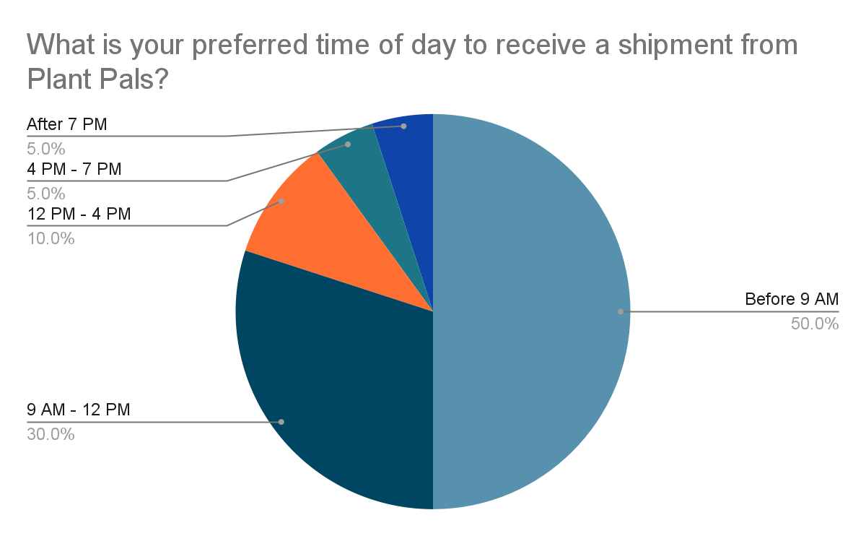
What is your preferred time of day to receive a shipment from Plant Pals?
[Insert chart or graph here]
Key takeaways & action items: High demand for early morning deliveries. Adjust logistics to prioritize morning delivery spots.

Slide 4
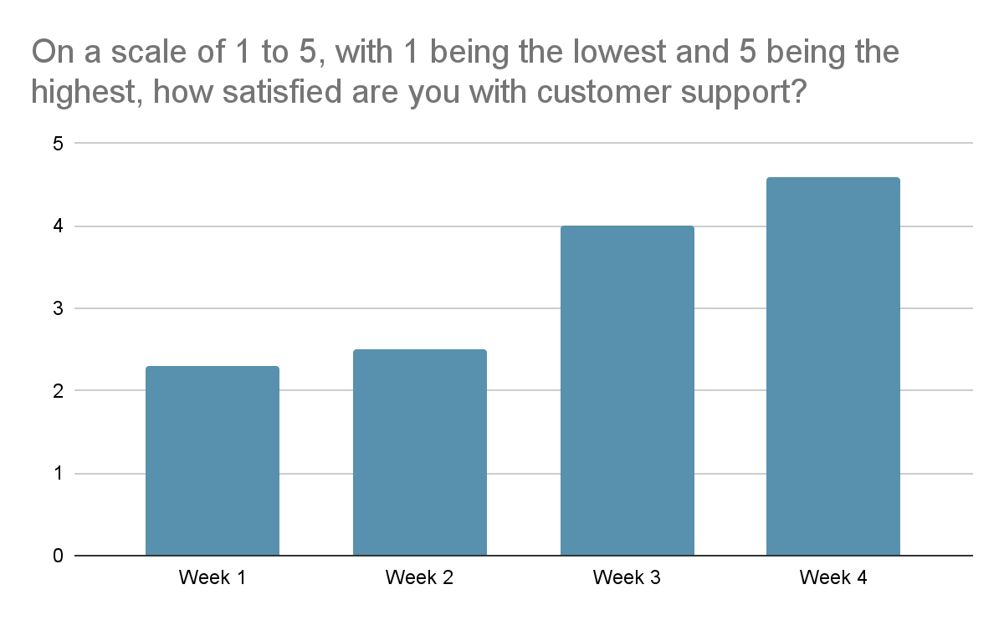
On a scale of 1 to 5, with 1 being the lowest and 5 being the highest, how satisfied are you with customer support?
[Insert chart or graph here]
Key takeaways & action items: Significant improvement in customer support satisfaction. Continue current support strategies and seek further enhancements.

Slide 5
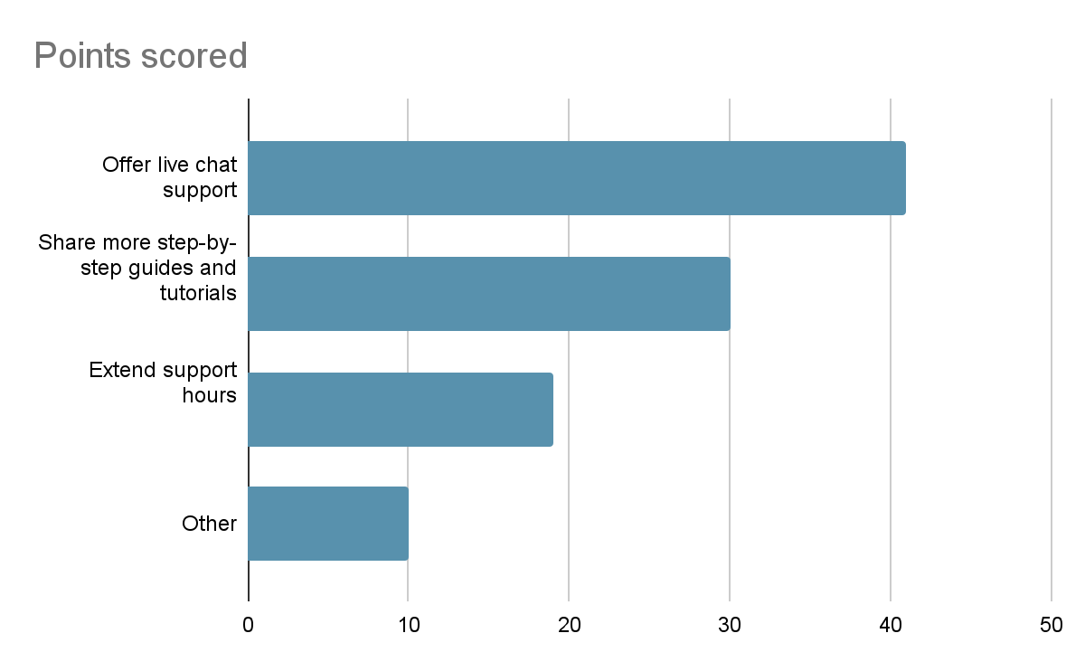
In general, how do you suggest we improve our customer support?
[Insert chart or graph here]
Key takeaways & action items: Clear preference for more interactive and immediate support options. Implement live chat support and enhance tutorial resources.

Slide 6
Conclusion and next steps
Successful Resolutions
Highlight improvements in delivery timelines and customer support satisfaction
Recommendations for Improvement
Focus on refining delivery schedules to meeting preferences and enhancing customer support with live chat functionality.
Future Considerations
Monitor customer feedback continuously to adapt to changing needs and expectations.

